Slide 1
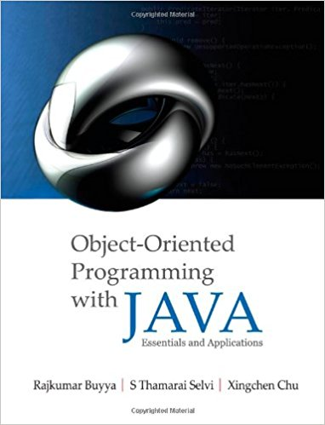
Inter-Process Communication (IPC): Network Programming using TCP Java Sockets
Dr. Rajkumar Buyya
Cloud Computing and Distributed Systems (CLOUDS) Laboratory
School of Computing and Information Systems
The University of Melbourne, Australia
http://www.buyya.com

Slide 2
Agenda
Introduction
Networking Basics
Understanding Ports and Sockets
Java Sockets
  Implementing a Server
  Implementing a Client
Sample Examples
Conclusions

Slide 3







Introduction
Internet and WWW have emerged as global ubiquitous media for communication and are changing the way we conduct science, engineering, and commerce.
They are also changing the way we learn, live, enjoy, communicate, interact, engage, work, etc. That means, the modern life activities are getting completely driven by the Internet.

Slide 4


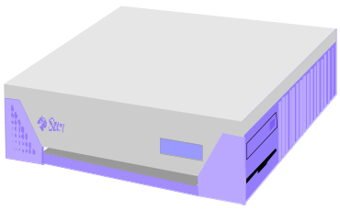
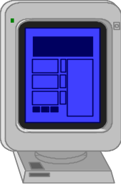

Internet Applications Serving Both Local and Remote Users
PC client
Internet Server
Local Area Network
PDA

Slide 5
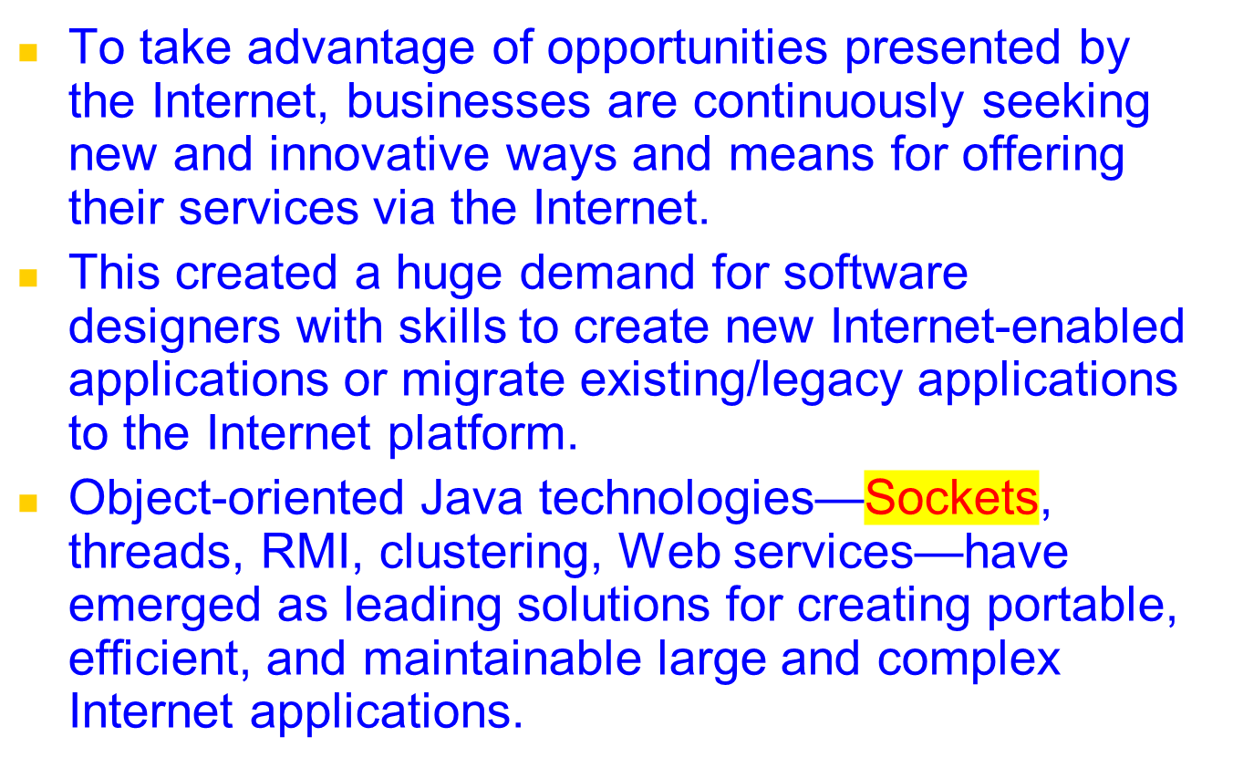
Increasing Demand for Internet Applications

Slide 6


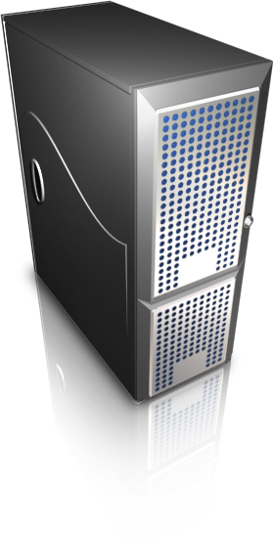
Elements of Client-Server Computing/Communication
a client, a server, and network
request
result
network
client
server
Processes follow protocols that define a set of rules that must be observed by participants:
  How is the data exchange encoded?
  How are events (sending, receiving) synchronized (ordered) so that participants can send and receive data in a coordinated manner?
In face-to-face communication, humans follow unspoken protocols based on eye contact, body language, gesture.

Slide 7
Networking Basics
Physical/Link Layer
  Functionalities for transmission of signals representing a stream of data from one computer to another
Internet/Network Layer
  IP (Internet Protocols) – a packet of data to be addressed to a remote computer and delivered
Transport Layer
  Functionalities for delivering data packets to a specific process on a remote computer
  TCP (Transmission Control Protocol)
  UDP (User Datagram Protocol)
  Programming Interface:
    Sockets
Applications Layer
  Message exchange between standard or user applications:
    HTTP, FTP, Telnet, Skype,…
TCP/IP Stack
Application
(http,ftp,telnet,…)
Transport
(TCP, UDP,..)
Internet/Network
(IP,..)
Physical/Link
(device driver,..)

Slide 8
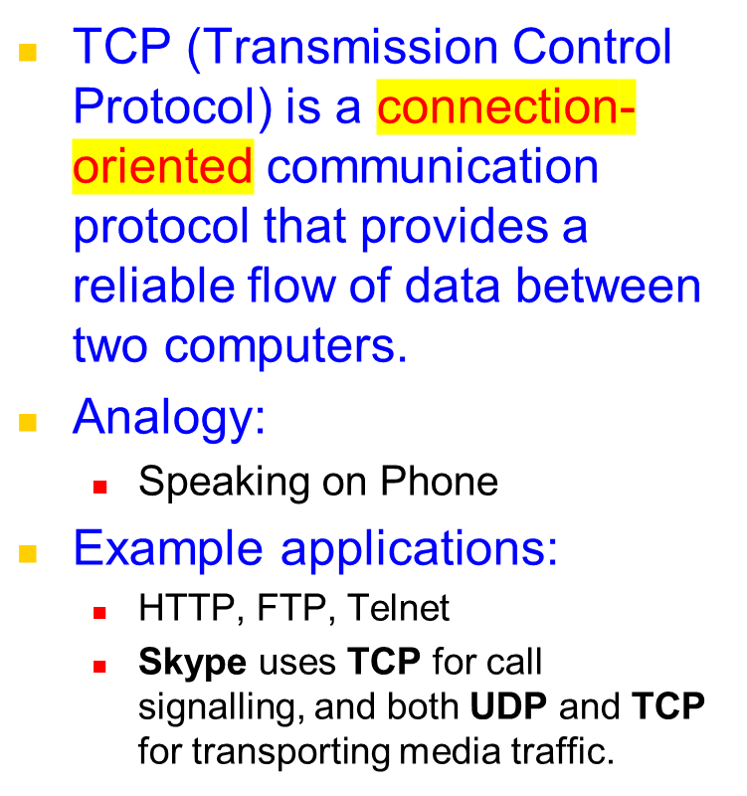
Networking Basics
TCP/IP Stack
Application
(http,ftp,telnet,…)
Transport
(TCP, UDP,..)
Internet/Network
(IP,..)
Physical/Link
(device driver,..)

Slide 9
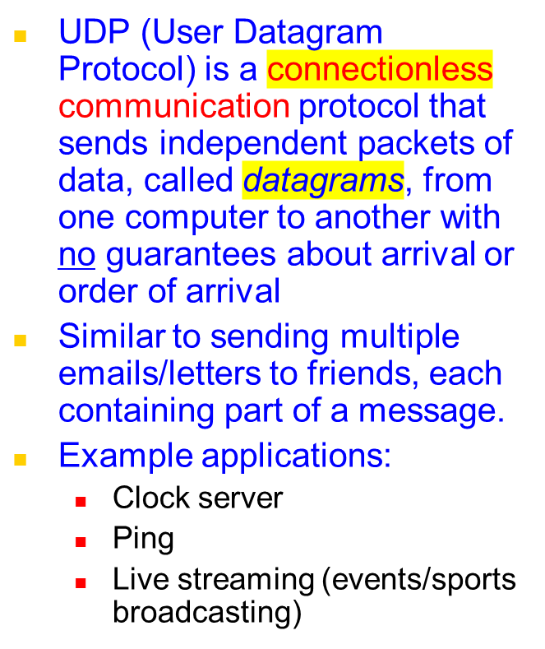
Networking Basics
TCP/IP Stack
Application
(http,ftp,telnet,…)
Transport
(TCP, UDP,..)
Network
(IP,..)
Link
(device driver,..)

Slide 10
TCP Vs UDP Communication
A
B
…
Connection-Oriented Communication
A
B
…
Connectionless Communication

Slide 11
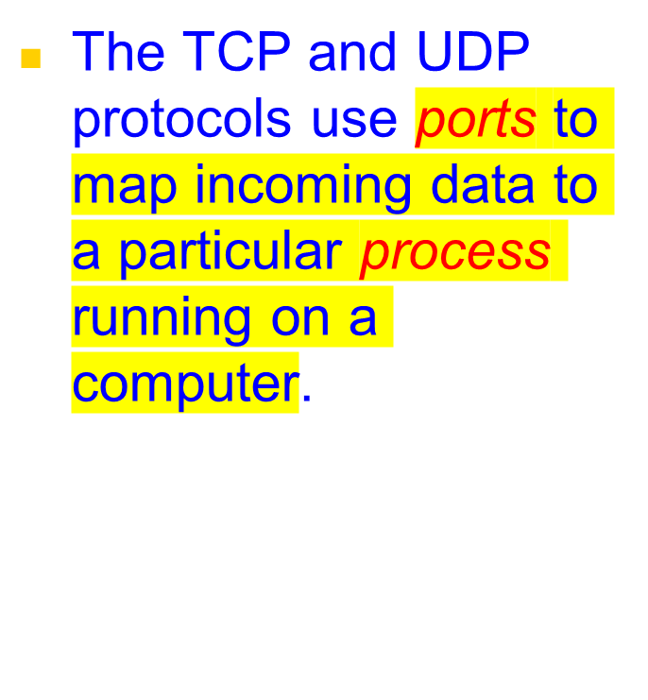
Understanding Ports
server
P
o
r
t
TCP
Client
app
app
app
app
port
port
port
port
TCP or UDP
Packet
Data
port#
data

Slide 12
Understanding Ports
Port is represented by a positive (16-bit) integer value
Some ports have been reserved to support common/well known services (IETF standard):
  ftp 21/tcp
  telnet 23/tcp
  smtp 25/tcp
  http 80/tcp
  login 513/tcp
  https://en.wikipedia.org/wiki/List_of_TCP_and_UDP_port_numbers
User-level processes/services generally use port number value >= 1024

Slide 13
Sockets
Sockets provide an interface for programming networks at the transport layer
Network communication using Sockets is very much similar to performing file I/O
  In fact, socket handle is treated like file handle.
  The streams used in file I/O operation are also applicable to socket-based I/O
Socket-based communication is programming language independent.
  That means, a socket program written in Java language can communicate with a program written in Java or non-Java socket programs.

Slide 14
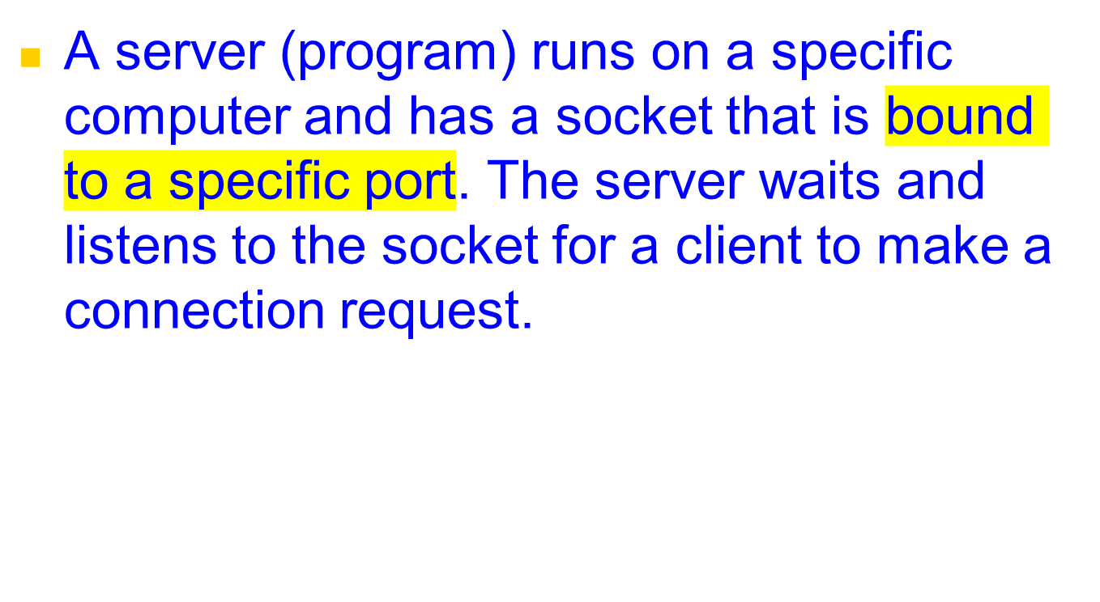
Socket Communication
server
Connection request
port
Client

Slide 15
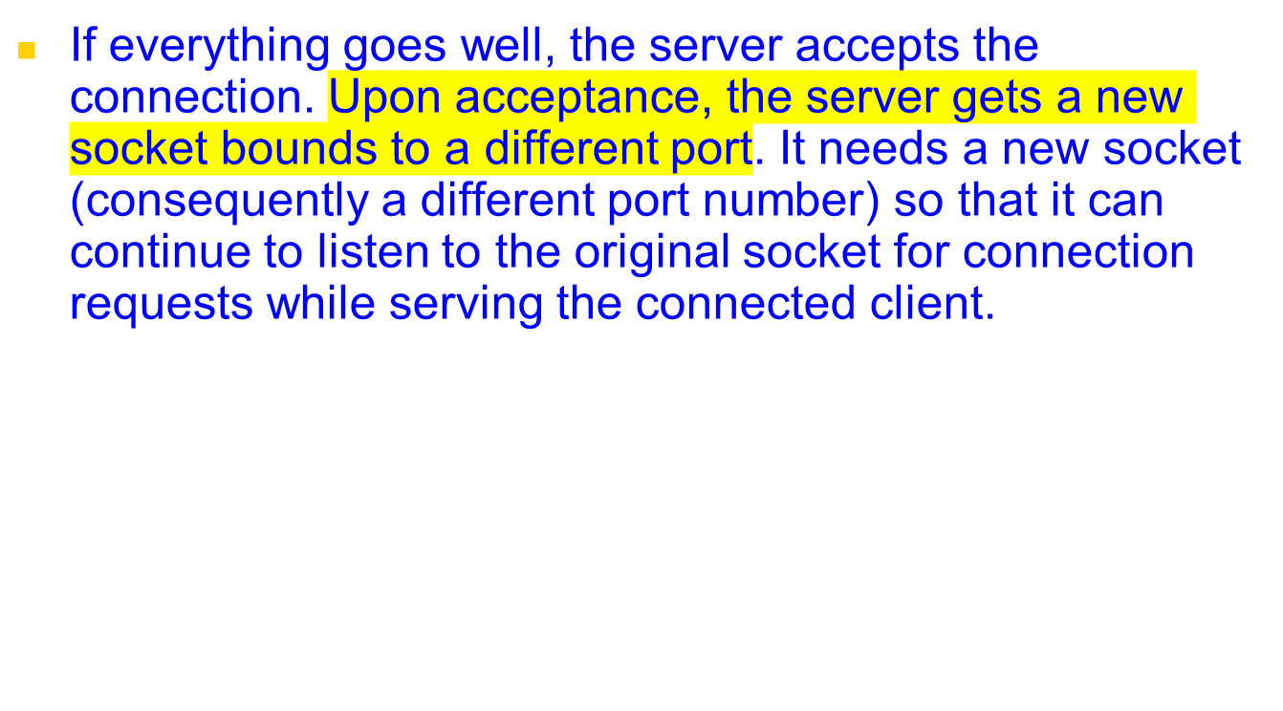
Socket Communication
server
port
port
Client
port
Connection

Slide 16
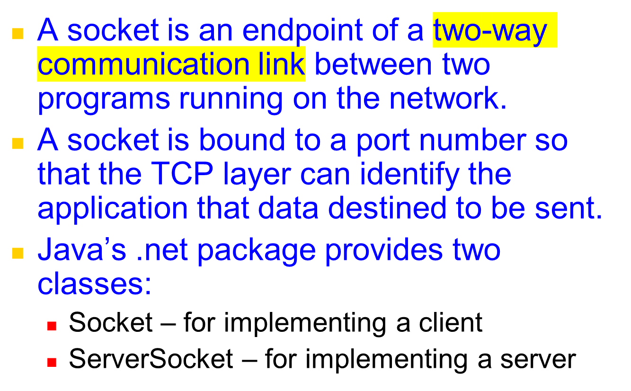
Sockets and Java Socket Classes

Slide 17
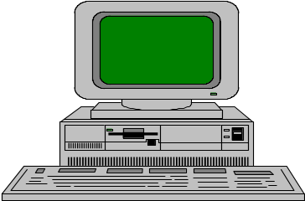
Java Sockets
Server
ServerSocket(1234)
Output/write stream
Client
Input/read stream
Socket(“128.250.22.134”, 1234)
It can be host_name like “clouds.cis.unimelb.edu.au”

Slide 18
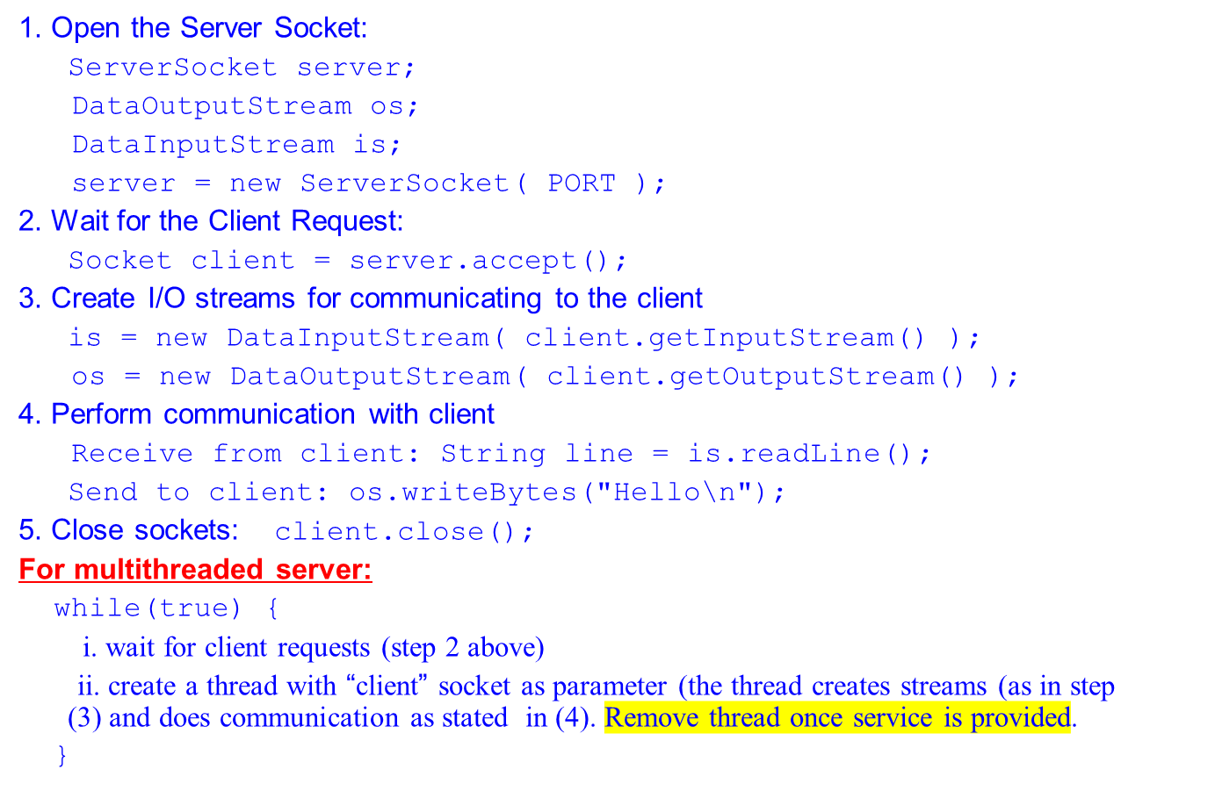
Implementing a Server

Slide 19
Implementing a Client
1. Create a Socket Object:
client = new Socket( server, port_id );
2. Create I/O streams for communicating with the server.
is = new DataInputStream(client.getInputStream() );
os = new DataOutputStream( client.getOutputStream() );
3. Perform I/O or communication with the server:
  Receive data from the server:
String line = is.readLine();
  Send data to the server:
os.writeBytes("Hello\n");
4. Close the socket when done:
client.close();

Slide 20
A simple server (simplified code)
// SimpleServer.java: a simple server program
import java.net.*;
import java.io.*;
public class SimpleServer {
public static void main(String args[]) throws IOException {
// Register service on port 1234
ServerSocket s = new ServerSocket(1234);
Socket s1=s.accept(); // Wait and accept a connection
// Get a communication stream associated with the socket
OutputStream s1out = s1.getOutputStream();
DataOutputStream dos = new DataOutputStream (s1out);
// Send a string!
dos.writeUTF("Hi there");
// Close the connection, but not the server socket
dos.close();
s1out.close();
s1.close();
}
}

Slide 21
A simple client (simplified code)
// SimpleClient.java: a simple client program
import java.net.*;
import java.io.*;
public class SimpleClient {
public static void main(String args[]) throws IOException {
// Open your connection to a server, at port 1234
Socket s1 = new Socket(“clouds.cis.unimelb.edu.au",1234);
// Get an input file handle from the socket and read the input
InputStream s1In = s1.getInputStream();
DataInputStream dis = new DataInputStream(s1In);
String st = new String (dis.readUTF());
System.out.println(st);
// When done, just close the connection and exit
dis.close();
s1In.close();
s1.close();
}
}

Slide 22
Run
Run Server on mundroo.cs.mu.oz.au
  [raj@mundroo] java SimpleServer &
Run Client on any machine (including mundroo):
  [raj@mundroo] java SimpleClient
  Hi there
If you run client when server is not up:
  [raj@mundroo] sockets [1:147] java SimpleClient
  Exception in thread "main" java.net.ConnectException: Connection refused
  at java.net.PlainSocketImpl.socketConnect(Native Method)
  at java.net.PlainSocketImpl.doConnect(PlainSocketImpl.java:320)
  at java.net.PlainSocketImpl.connectToAddress(PlainSocketImpl.java:133)
  at java.net.PlainSocketImpl.connect(PlainSocketImpl.java:120)
  at java.net.Socket.<init>(Socket.java:273)
  at java.net.Socket.<init>(Socket.java:100)
  at SimpleClient.main(SimpleClient.java:6)

Slide 23
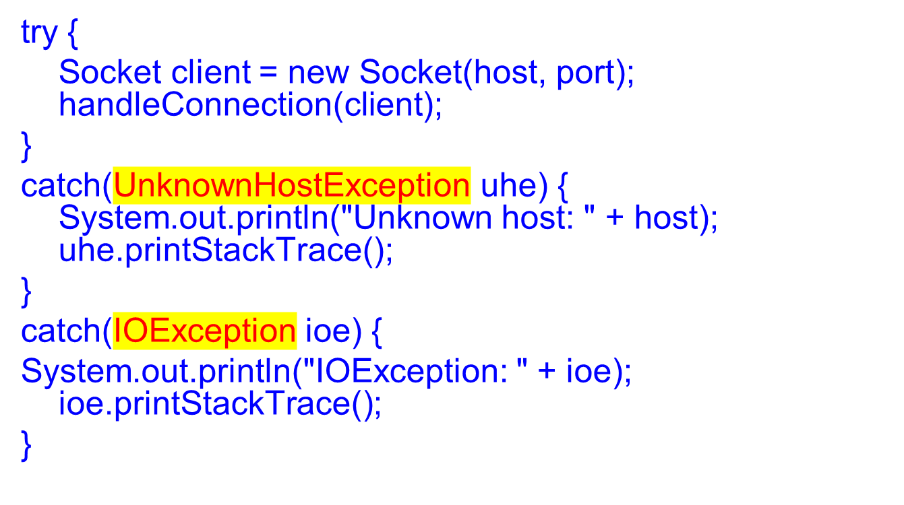
Socket Exceptions

Slide 24
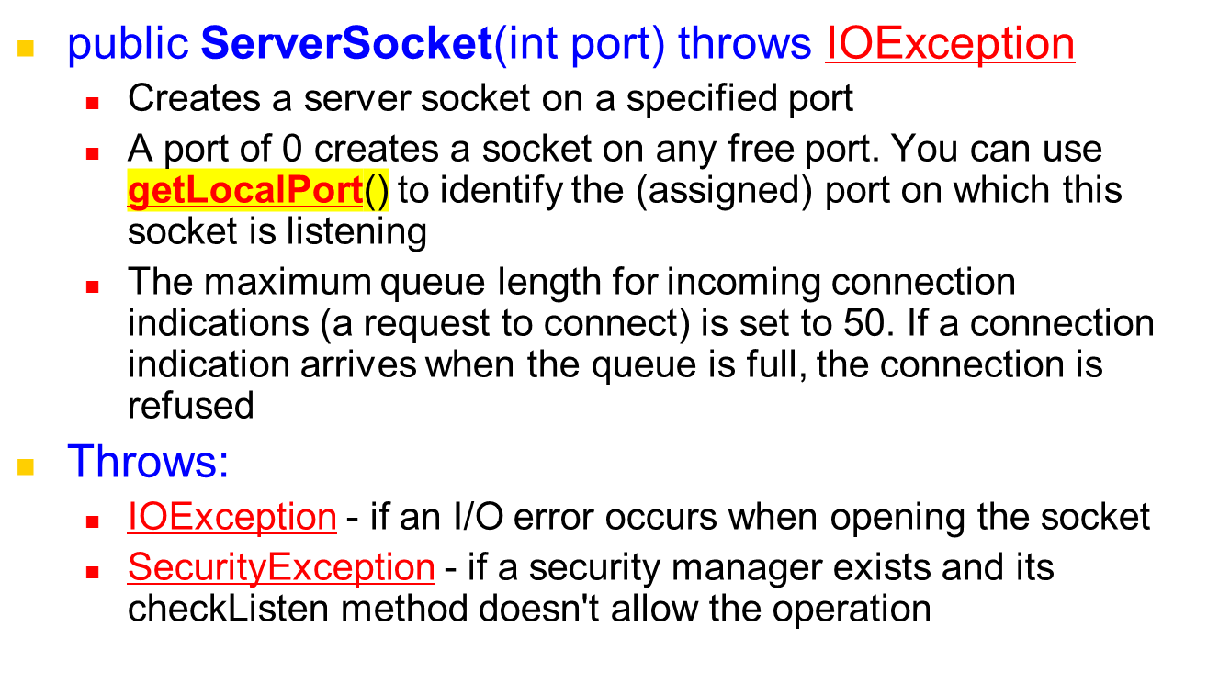
ServerSocket & Exceptions

Slide 25
Server in Loop: Always up
// SimpleServerLoop.java: a simple server program that runs forever in a single thead
import java.net.*;
import java.io.*;
public class SimpleServerLoop {
public static void main(String args[]) throws IOException {
// Register service on port 1234
ServerSocket s = new ServerSocket(1234);
while(true)
{
Socket s1=s.accept(); // Wait and accept a connection
// Get a communication stream associated with the socket
OutputStream s1out = s1.getOutputStream();
DataOutputStream dos = new DataOutputStream (s1out);
// Send a string!
dos.writeUTF("Hi there");
// Close the connection, but not the server socket
dos.close();
s1out.close();
s1.close();
}
}
}

Slide 26
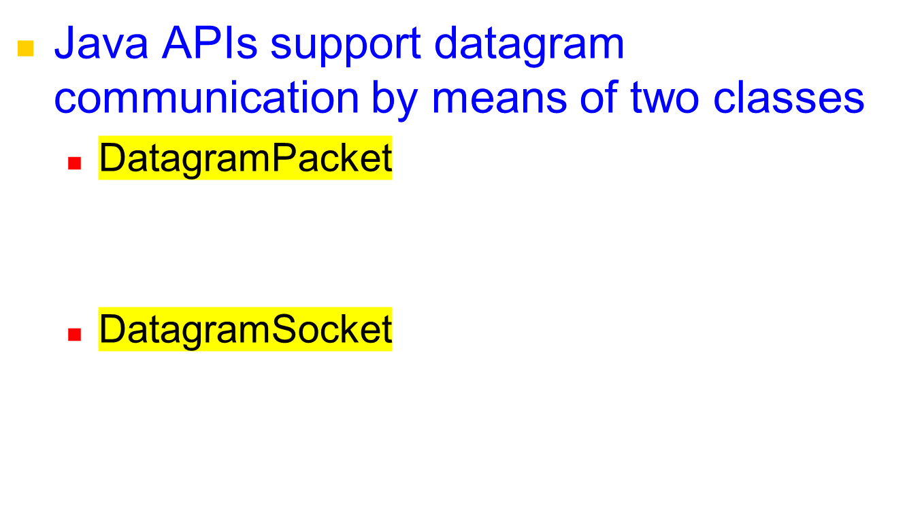
Java API for UDP Programming
| Msg | length | Host | serverPort |

Slide 27
UDP Client: Sends a Message and Gets reply
import java.net.*;
import java.io.*;
public class UDPClient
{
public static void main(String args[]){
// args give message contents and server hostname
// "Usage: java UDPClient <message> <Host name> <Port number>"
DatagramSocket aSocket = null;
try {
aSocket = new DatagramSocket();
byte [] m = args[0].getBytes();
InetAddress aHost = InetAddress.getByName(args[1]);
int serverPort = 6789; // Or Integer.valueOf(args[2]).intValue() if use <Port number> args[2]
DatagramPacket request = new DatagramPacket(m, args[0].length(), aHost, serverPort);
aSocket.send(request);
byte[] buffer = new byte[1000];
DatagramPacket reply = new DatagramPacket(buffer, buffer.length);
aSocket.receive(reply);
System.out.println("Reply: " + new String(reply.getData()));
}
catch (SocketException e){System.out.println("Socket: " + e.getMessage());}
catch (IOException e){System.out.println("IO: " + e.getMessage());}
finally
{
if(aSocket != null) aSocket.close();
}
}
}

Slide 28
UDP Sever: repeatedly received a request and sends it back to the client
import java.net.*;
import java.io.*;
public class UDPServer{
public static void main(String args[]){
DatagramSocket aSocket = null;
try{
aSocket = new DatagramSocket(6789); // fixed port number
byte[] buffer = new byte[1000];
while(true){
DatagramPacket request = new DatagramPacket(buffer, buffer.length);
aSocket.receive(request);
DatagramPacket reply = new DatagramPacket(request.getData(),
request.getLength(), request.getAddress(), request.getPort());
aSocket.send(reply);
}
}catch (SocketException e){System.out.println("Socket: " + e.getMessage());}
catch (IOException e) {System.out.println("IO: " + e.getMessage());}
finally {if(aSocket != null) aSocket.close();}
}
}

Slide 29



Multithreaded Server: For Serving Multiple Clients Concurrently
Server Process
Client Process 2
Server threads
Client Process 1

Slide 30
Summary
Programming client/server applications in Java is fun and challenging.
Programming socket programming in Java is much easier compared to doing it in other languages such as C.
TCP for Connection-oriented communication, more reliable, flow control.
UDP for connection-less communication
Keywords:
  Clients, servers, TCP/IP, port number, sockets, Java sockets

Slide 31
References
Chapter 13: Socket Programming
  R. Buyya, S. Selvi, X. Chu, “Object Oriented Programming with Java: Essentials and Applications”, McGraw Hill, New Delhi, India, 2009.
  Sample chapters at book website: http://www.buyya.com/java/

